Slide 1
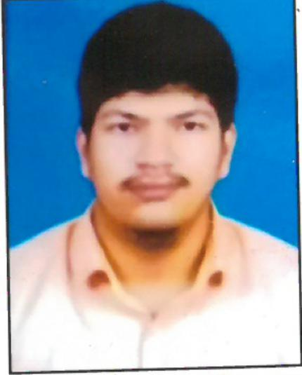



J S C Srinivas Kumar
Analyst/Software Engineer
Bachelor of Engineering
Electronics and Communications Engineering: 2017 - 2021
Skills Java 8
Spring Boot
Spring MVC
Angular CRUD
Full Stack
Angular
Spring
MongoDB
Database
No SQL database – MongoDB
Web Technologies
HTML5
CSS3
Javascript
Typescript
AddOns
Github
Maven
Postman
Additional Details
Good Communication Skills
Team Player.
Bangalore
j-s-c-Srinivas.Kumar@capgemini.com
+91 9989390573
A4
Hands on Experience in Creating Microservices using Spring Boot , Spring Cloud API, Eureka Server.
Experienced in Unit Testing the Middle End Spring Boot using Junit .
Positive Attitude and Strong Work Ethics to stay Helpful while working.
Team Player with good Communication Skills and always Striving to Provide Good Results.
Willingness to learn New Technologies and Increase my Knowledge and Skills.
Online Railway Reservation System Application
Created and completed the online Railway Reservation System Case Study using Java Full Stack with Angular.
Multiple Microservices Implemented using Spring Boot and Spring Cloud and Connecting them with Discovery Server.
Created the Frontend Using Angular 12 and Angular CLI for a User Friendly Interface
Created the Backend Using MongoDB Atlas .
Completed the I-Transform Java Full Stack Angular Training
Check out my work on GitHub & Video Profile

